Slide 1
Representation of basic elementary continuous time signals
Signals and Communication Systems (SCS)
Session-3

Slide 2
Basic Singularity Functions
Signals and Communication Systems (SCS)
Session-4

Slide 3
Basic Singularity Functions

Slide 4
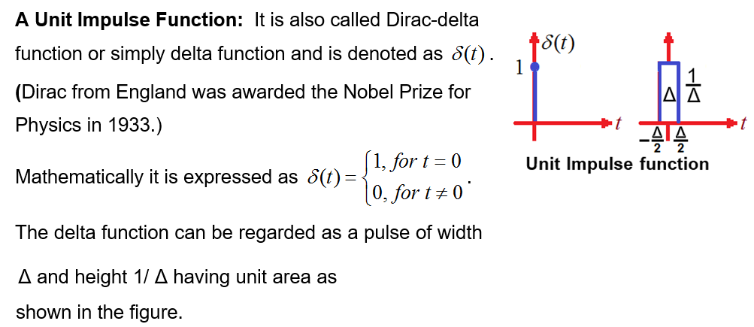
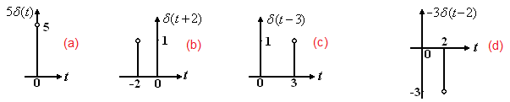
A Unit Impulse Function

Slide 5
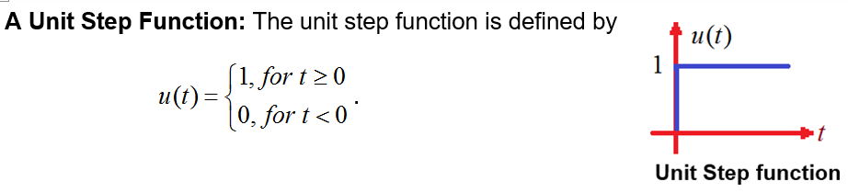

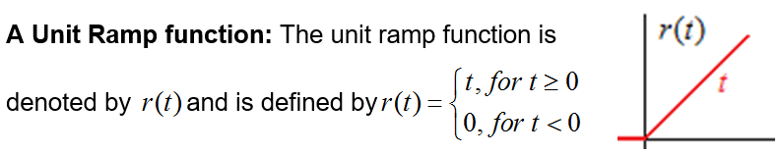



Slide 6







Slide 7
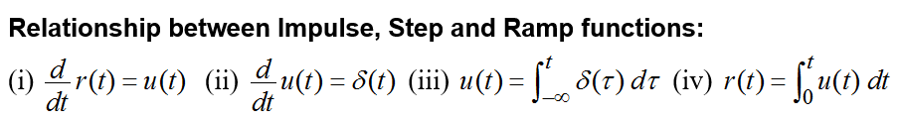
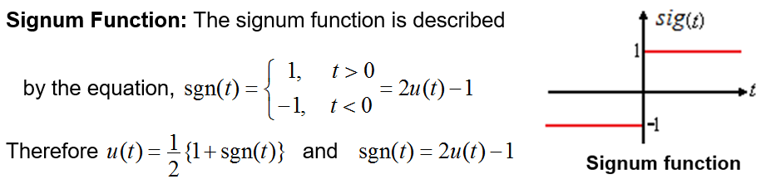

Slide 8





Properties of Singularity functions

Slide 9
Properties of Singularity functions

Slide 10
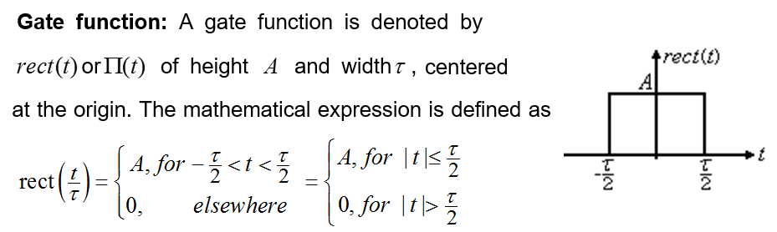
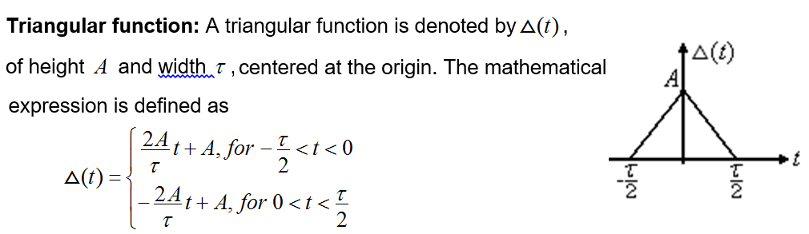

Slide 11
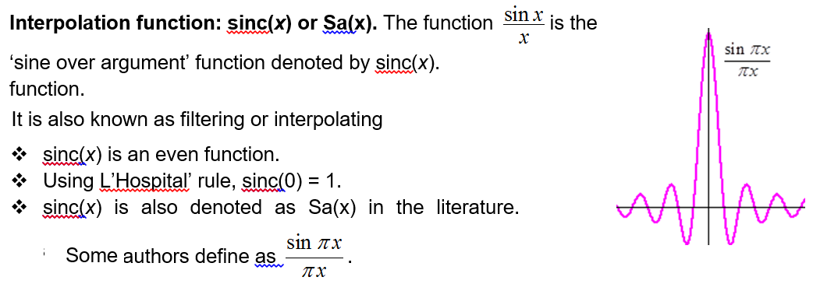

Slide 12
End

